Slide 1



Disney movies and Box Office Success
Submitted By,
Name : R. Gayathri Enrollment Number : EBEON0322583927
Batch : 7229-2021 DA
Chennai EXL

Slide 2

About Disney
Walt Disney Studios is the foundation on which The Walt Disney Company was built.
The Studios has produced more than 600 ﬁlms since their debut ﬁlm, Snow White and the Seven Dwarfs in 1937. While many of its ﬁlms were big hits, some of them were not.

Slide 3

Import of data
Cleaning of data :
Data cleaning is the process of ﬁxing or removing incorrect, corrupted, incorrectly formatted, duplicate, or incomplete data within a dataset. When combining multiple data sources, there are many opportunities for data to be duplicated or mislabeled.
Top ten movies at the box oﬃce
Movie genre trend
Visualize the genre popularity trend
Data transformation
The genre eﬀect
LinearRegression

Slide 4

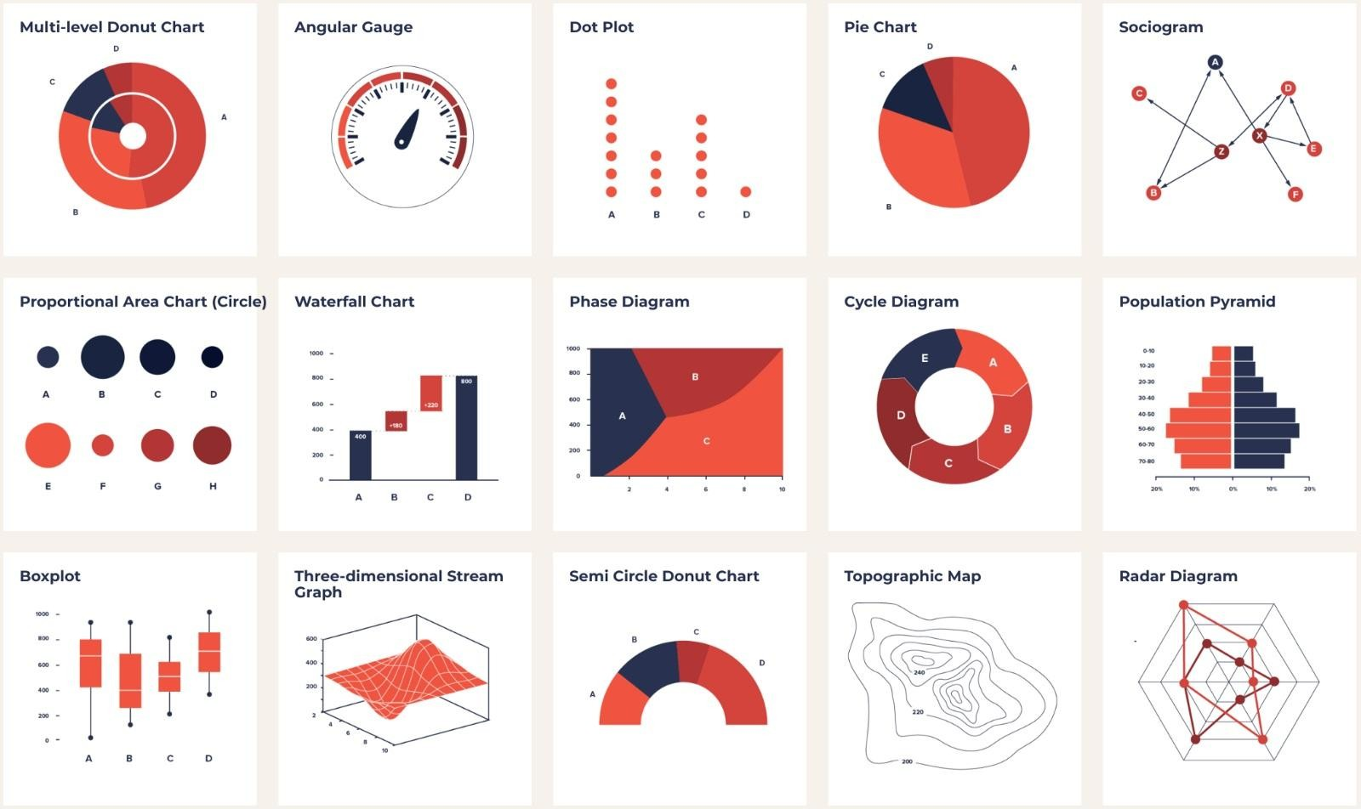
Exploratory Data Analysis

Slide 5

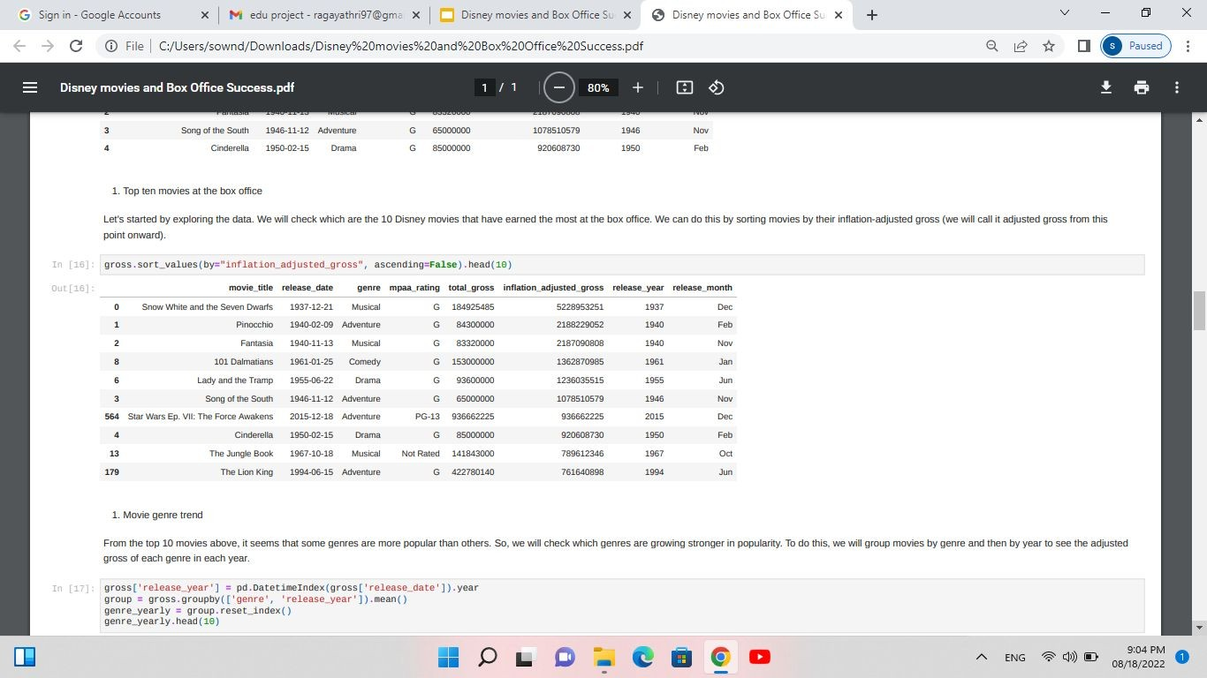
Top ten movies at the box oﬃce

Slide 6

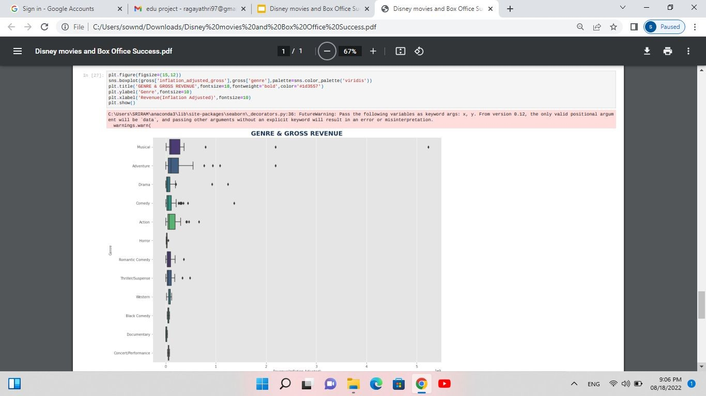
Movie genre trend

Slide 7
Visualisation
The process of finding trends and correlations in our data by representing it pictorially is called Data Visualization. To perform data visualization in python, we can use various python data visualization modules such as Matplotlib, Seaborn, Plotly, etc
In my project iam showing
release_year-inflation_adjusted_gross
Total Gross-Frequency, Inflation Adjusted Gross-Frequency
Genre-Revenue(Inflation Adjusted)
Trend Of Genre's By Release Month

Slide 8
Linear Regression
Is used to predict the value of a variable based on the value of another variable. The variable you want to predict is called the dependent variable. The variable you are using to predict the other variable's value is called the independent variable.
In my project, I want (action, adventure) (102921757.36842175, 87475654.70909745)

Slide 9
Conclusion
The confidence intervals from the bootstrap method for the intercept and coefficient do not contain the value zero, as we have already seen that lower and upper bounds of both confidence intervals are positive. These tell us that it is likely that the adjusted gross is significantly correlated with the action and adventure genres. From the results of the bootstrap analysis and the trend plot we have done earlier, we could say that Disney movies with plots that fit into the action and adventure genre, according to our data, tend to do better in terms of adjusted gross than other genres.

Slide 10
Any Questions ?

Slide 11
Thank You !

